Slide 1
HYPOTHESIS TESTING
By Vibhav Mann

Slide 2
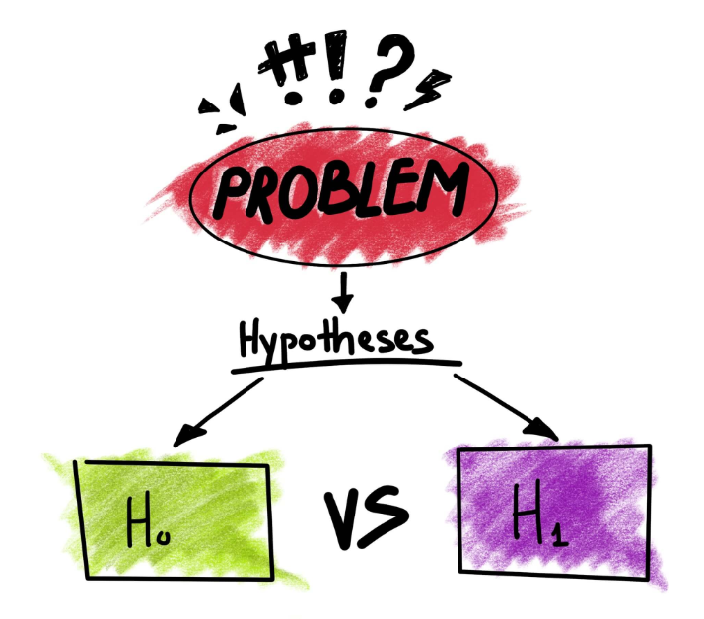
Introduction to Hypothesis Testing
Hypothesis Testing - Helps us to statistically verify whether a claim is likely to be true for an entire population or not.
Maggi v FSSAI (Food Safety and Standards Authority of India) as an example. Permissible limit, say, is 2.5ppm of lead.
Does diet help more in reducing weight or does exercise help more?
In order to quit smoking, do Nicotine Patches actually work?
In hypothesis testing there are two types of hypothesis based on the test that is to be done – Null Hypothesis and Alternate Hypothesis.

Slide 3
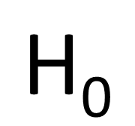
Brief introduction to null hypothesis
Null hypothesis means that the status quo is true, it means that the original belief/claim of a hypothesis is true.
Considering the examples of the previous slide :
Maggi v FSSAI – Permissible limit of lead is 2.5ppm. Null Hypothesis - “Maggi products contain lead content equivalent to or lower than 2.5ppm”
Similarly, in the example for knowing whether diet helps more in reducing weight or exercise, we can consider that the null hypothesis could be that there was no difference in the average weight loss for both methods of dieting and exercise.
In the example for whether quitting smoking is more efficient using Nicotine Patches, we can assume the null hypothesis to be that it does not help.

Slide 4

Brief introduction to ALTERNATE hypothesis
Alternate Hypothesis claims that the status quo is not true, it states that the claim that has been made regarding the hypothesis is not true.
Alternate Hypothesis is opposite to the null hypothesis in nature.
Examples :
Maggi vs FSSAI – Alternate Hypothesis would be that the lead content is not within the permissible limit and is more than the permissible limit of 2.5ppm.
Similarly, in the second example, the alternate hypothesis would be that a difference was noted for both methods of dieting and exercise.
In the third example, the alternate hypothesis would be that Nicotine Patches are actually helpful in quitting smoking

Slide 5
Mathematical representations for null and alternate hypothesis
Mathematically, null hypothesis is denoted by H₀ and it is always formulated by either “ = ” or “ ≤ ” or “ ≥ ” symbols.
Alternate Hypothesis is denoted by H_{a} or H₁ and is formulated using “ ≠ ” or “ < ” or “ > ” symbols.
Note that if the claim statement has, “ > ” or “ < “ signs, then the null hypothesis would be compliment of the claim statement and in this case, the alternate hypothesis would be the claim statement itself. The null hypothesis need not always be the claim statement, it could also be the complement. The best way to decide is by looking at the operator sign. Example - Goodyear claims that each of its tyres can travel more than 7500 miles on average before they need any replacement.

Slide 6
Important terminologies for Hypothesis testing
Let us consider a random example in which your friend claims that he/she averages a score of 20 points in each basketball game he/she plays.
Null Hypothesis : Friend averages 20 points as claimed.
Alternate Hypothesis : Friend does not average 20 points as claimed.
Population Mean Score : The population mean score is the average mean score that your friend claims to have scored over a set of games. The population mean score in this case would be 20. It is denoted by “ μ ”.

Slide 7
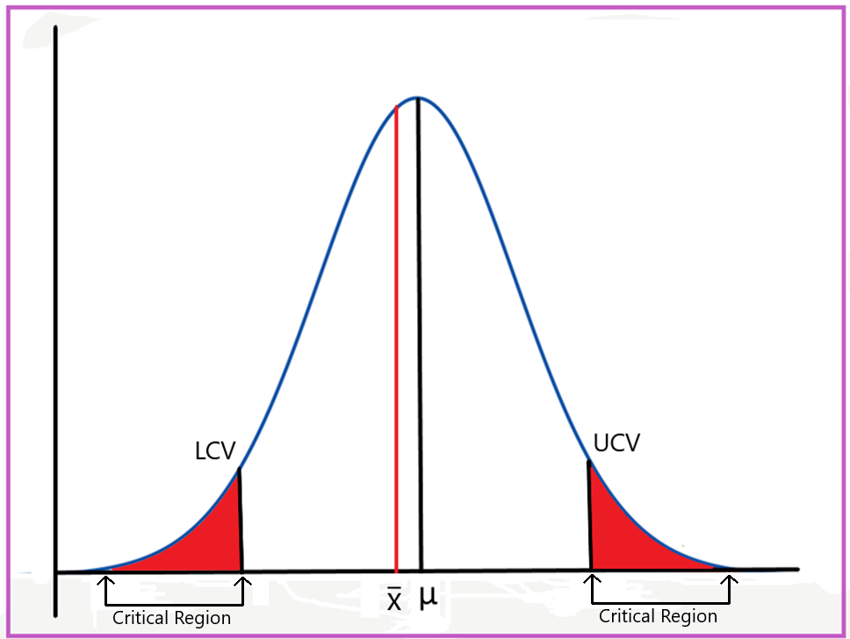
Important terminologies for Hypothesis testing (Contd..)
Lower Critical Value (LCV) : Lower critical value is the point below which we would claim that the average score of your friend is below 20. In this case he/she has been overestimating his/her score.
Upper Critical Value (UCV) : Upper Critical Value is the point above which we would claim that the average score of your friend is above 20.
Critical Region/Rejection Region : The region above the UCV and below the LCV is called the critical region. This is the area that gives us statistical significance to reject the null hypothesis.

Slide 8

Important terminologies for Hypothesis testing (CONTD..)
Acceptance Region : The region between the LCV and the UCV is called the acceptance region.
Sample Mean : Sample Mean is the mean of the sample data that we take. It is denoted by “ ”.
Significance Level : Significance Level is the probability of making an error. There is a possibility that even after obtaining statistical evidence, we were making an error. This is where the significance level comes in. We want to minimise the probability of making an error and hence, we take a certain significance value to minimise the error. Generally, this value is taken to be 5% but according to our requirements, we can increase or decrease this value. This denotes that there is a 5% or 0.05 probability that we are making an error and thus, we can be confident of our hypothesis. It is denoted by “ α ”.
Z-Critical Value : Z-Critical Value is the Z-score attached to the critical value. It is denoted by “ Zc ”.

Slide 9
Critical region in relation to alternate hypothesis
The critical region depends upon the nature of the alternate hypothesis.
I claim that I can have 4 burgers at a time. The null hypothesis automatically would be that I can have 4 burgers i.e., H₀ : μ = 4. The alternate hypothesis, thus, would become that I can have either less than or more than 4 burgers i.e., H₁ : μ ≠ 4. This kind of an alternate hypothesis is called a Non Directional Hypothesis as we cannot say if the sample mean would be lesser than or greater than 4 until unless we have sufficient statistical evidence to make a decision.
Lower Critical Value - below which we could say that I can only have less than 4 burgers.
Upper Critical Value - above which we can say that I can have more than 4 burgers.

Slide 10
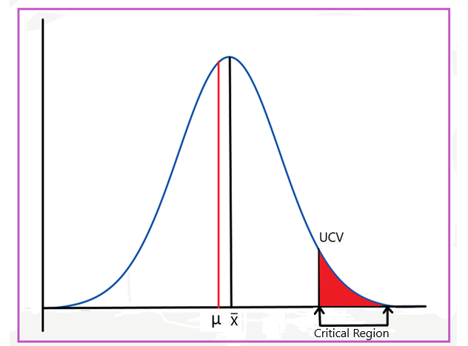
Critical region in relation to alternate hypothesis (CONTD..)
But if we alter the same example statement and I claim that I can have at most 4 burgers, the following changes would happen :
The null hypothesis would become that I can have 4 or less than 4 burgers i.e., H₀ : μ ≤ 4. The alternate hypothesis would now become that I can have more than 4 burgers i.e., H₁ : μ > 4. This type of an alternate hypothesis is called a Directional Hypothesis as now we know that if the null hypothesis is rejected, the population mean would definitely be greater than the sample mean of 4.
There would exist only a UCV above which we could claim that I can have more than 4 burgers.

Slide 11
Types of tests
There are basically two types of tests :
Two-Tailed Tests ( ≠ in H₁ ) : Two Tailed tests are the tests wherein we have to check the rejection region or critical region on both sides of the distribution. These tests would have both LCV and UCV.
One-Tailed Tests : One Tailed tests are the tests wherein the rejection region or the critical region lies on only one side of the distribution. This test could either have an LCV or a UCV. One Tailed tests are of two types:
Upper Tailed Tests (> in H₁ ) : In these tests, the rejection region lies on the right side of the distribution.
Lower Tailed Tests (< in H₁ ) : In these tests, the rejection region lies on the left side of the distribution.

Slide 12
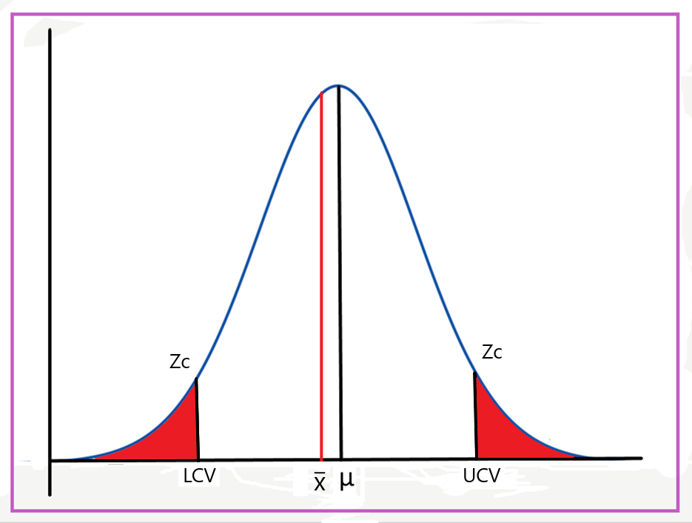
Two Tailed test
This is how the distribution for a two tailed test looks like. There exists LCV and UCV, both, for such a distribution. There exists critical region on both sides of the population mean. The line in the middle is denoting the population sample mean and the red area under the curve denotes the critical or the rejection region. This type of a test is called a non directional test. The red line in the middle denotes the sample mean and the area between the LCV and the UCV is the acceptance region.

Slide 13
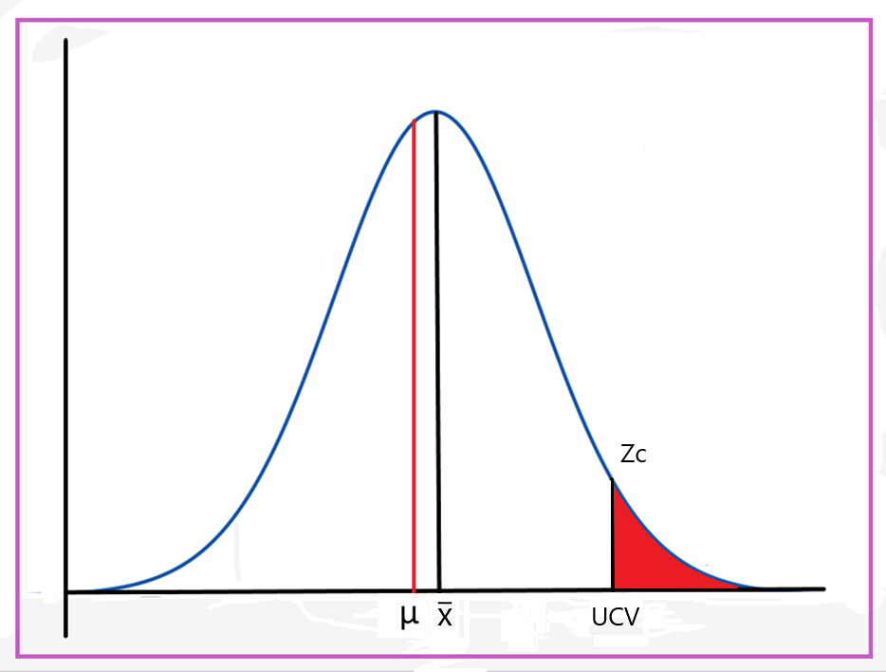
One Tailed test (Upper tailed)
This is how the distribution for an upper tailed test looks like. There exists a UCV for this and the line in the middle is denoting the population sample mean while the red area under the curve on the right hand side is denoting the critical or the rejection region. If the calculate mean of the sample lies in this red area, we can reject the null hypothesis. This is a type of a directional test. The red line in the middle denotes the Sample Mean and the area below the UCV is the acceptance region.

Slide 14
Methods to conduct hypothesis testing
There are multiple methods to conduct Hypothesis Testing. In this presentation, I’ll be discussing two methods only :
Critical Value Method
p-Value Method
Remember that we can never accept the null hypothesis. We can only fail to reject it due to insufficient statistical evidence. So, we only have only two options after doing a hypothesis test – Rejecting the null hypothesis or failing to reject the null hypothesis.

Slide 15
Critical Value Method
Let us consider an example to see how to statistically reject or fail to reject the null hypothesis. Let’s take the Maggi vs FSSAI example for this.
Say the permissible limit of lead in a Maggi product of 2.5ppm. Maggi claims that it does not exceed this limit while FSSAI says that Maggi is crossing the permissible limit. We take a sample size of 100 for this experiment, with a standard deviation of 0.6 and significance level of 3%. The sample mean is 2.6ppm. We need to check if a regulatory alarm is needed to be raised for excess amount of lead in the food samples.
The Null Hypothesis would be H₀ : μ ≤ 2.5 and the Alternate Hypothesis would be H₁ : μ > 2.5
σ(Standard Deviation) = 0.6
= 2.6 ppm
n(Sample Size) = 100
α(Significance Level) = 0.03 (3%)

Slide 16
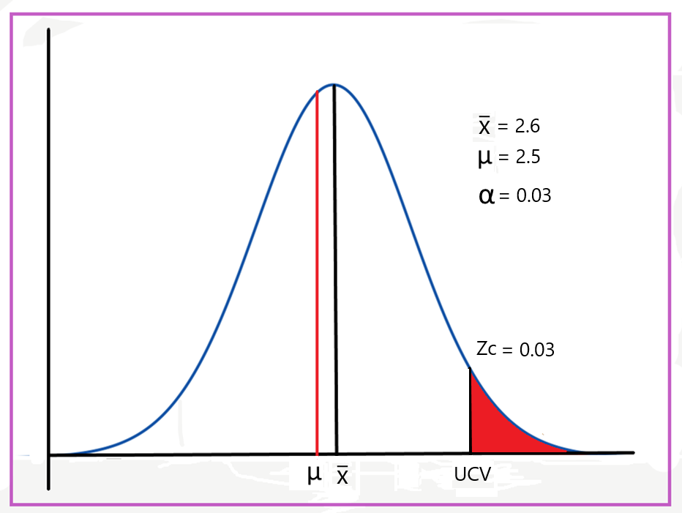
Maggi vs FSSAI graph
Since the alternate hypothesis states that H₁ : μ > 2.5, we can automatically infer that this is a one tailed (upper tailed) test. The “ > ” symbol implies that the critical value shall lie on the right side of the distribution. The red area under the curve i.e., the critical/rejection region is 3% of the total distribution and hence, the rest of the area which is the acceptance region is 97%. After obtaining sufficient statistical evidence, if the sample mean is less than the critical value(UCV), we can say that the sample mean lies in the acceptance region and then we can base our inferences on that. If the calculated sample mean does not lie in the acceptance region, we can say that we fail to reject the null hypothesis due to lack of evidence.

Slide 17
Calculating the critical value
Step 1 : Calculating the cumulative probability. The cumulative probability in this case would be (1-0.03)=0.970. Had the distribution been a two tailed distribution, 0.03 would have been divided equally on either sides of the distribution and in that case, the cumulative probability would have become (1-0.015)=0.985.
Step 2 : Now we would calculate the Z-score for the cumulative probability value of 0.970. This can be calculated using a Z-Table. On using, we find Zc = 1.88
Step 3 : Next step is to calculate the Critical Value for the Z-Score. The expression to calculate the Critical Value is given by [μ + Zc x (σ/√n)]. On using this expression, we find that UCV = 2.6128

Slide 18
Inference
UCV = 2.6128
= 2.6
We can see that the sample mean is less than the critical value(UCV), which means that the sample mean lies in the acceptance region. This means that we fail to reject the null hypothesis in this case. Hence, the claim made by Maggi shall not be rejected and there is no need to raise a regulatory alarm regarding the same.

Slide 19
P-Value method
In simple words, p-value is the probability that the null hypothesis is correct. So, if the p-value is higher, we would have a greater chance of not rejecting the null hypothesis. Very small p-values imply that we will reject the null hypothesis.
Let’s take a different example for the p-value method. This example is from the module itself.
The amount of paracetamol deemed safe by the drug regulatory authorities is 500 mg. If the amount of paracetamol is too low or too high, it will cause a regulatory issue.

Slide 20
P-Value method (Contd..)
The Null Hypothesis would be H₀ : μ = 500 and the Alternate Hypothesis would be H₁ : μ ≠ 500.
σ(Standard Deviation) = 110
= 510 mg
n(Sample Size) = 900
α(Significance Level) = 0.05 (5%)

Slide 21
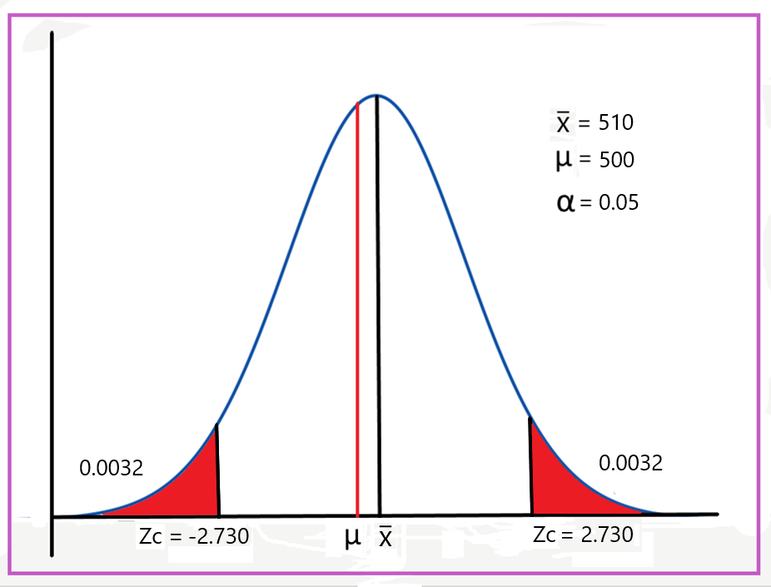
Graph
Since the alternate hypothesis states that H₁ : μ ≠ 500, the critical region or the rejection region will lie on both sides of the distribution as the sample mean could be lesser than 500 and it could also be greater than 500. The area under the probability distribution curve is the p-Value. Due to the test being a two-tailed test, it is distributed on either sides of it.

Slide 22
Calculating the p-value
Step 1 : The first step is to calculate the Z-score. Unlike the Critical Value method, in the p-Value method, we calculate the Z-score. The expression required to calculate the Z-Score is [( - μ ) / (σ /​√n)]. On calculating, we get Zc = 2.73
Step 2 : The next step is to find the value corresponding to the Z-Score of 2.73. This will help us calculate the p-Value. On referring to the Z-Table, the value corresponding to the Z-Score of 2.73 was found to be 0.9968
Step 3 : The final step is to calculate the p-Value. The p-Value is calculated by subtracting the value corresponding to the Z-Score from 1. But this is a two tailed test. Thus, the p-Value so obtained will be multiplied by 2 to get p-Value for the entire distribution.
p-Value = (1-0.9968)x2 = 0.0064

Slide 23
inference
If the p-Value is less than the significance level, we can reject the null hypothesis.
If the p-Value is more than the significance level, we fail to reject the null hypothesis.
Here, the p-value comes out to be 0.0064. The p-value is less than the significance level (0.0064 < 0.05) and a smaller p-value gives us greater evidence against the null hypothesis. So, we can reject the null hypothesis in this case that the average amount of paracetamol in medicines is 500 mg. So, this is a regulatory alarm for the company, and the manufacturing process needs to change.

